Slide 1

Playing Card Detection and Identification Dan Snyder
Motivation: I play a lot of tabletop card games. One thing I have found is that the programs commonly used to identify cards come with a set of restrictions such as card placement, and background setup.
Goal: When given an image, identify and recognize all cards from a standard 52 card deck of playing cards, regardless of location in the image.

Slide 2
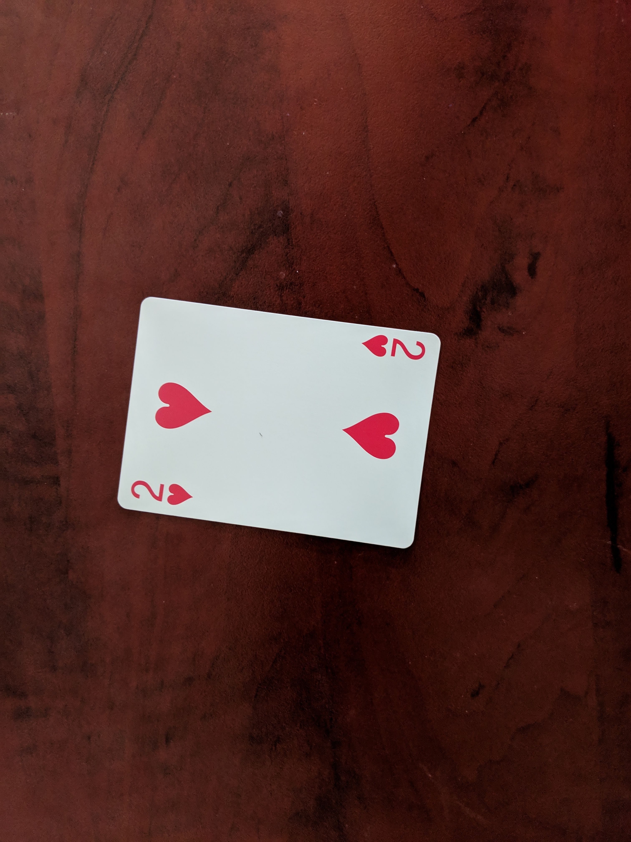
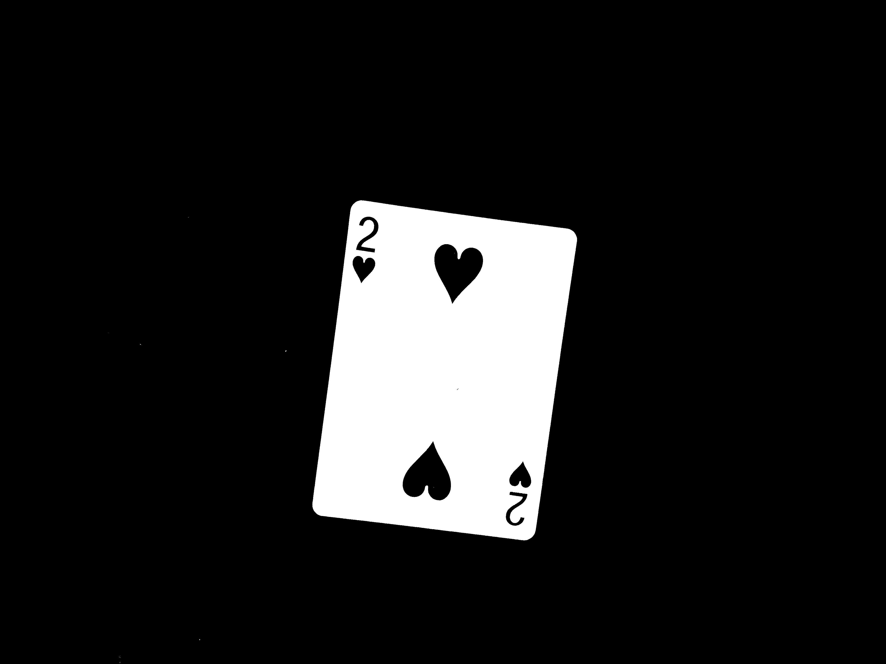
Approach and Considerations
Approach to problem
Detect where all the cards are in the image
Crop and rotate individual cards in preparation for identification using hough transform.
Identify the rank and suit of each card found in previous steps using template matching.
Additional Considerations
Identify cards in a variety of orientations and on a variety of backgrounds

Slide 3
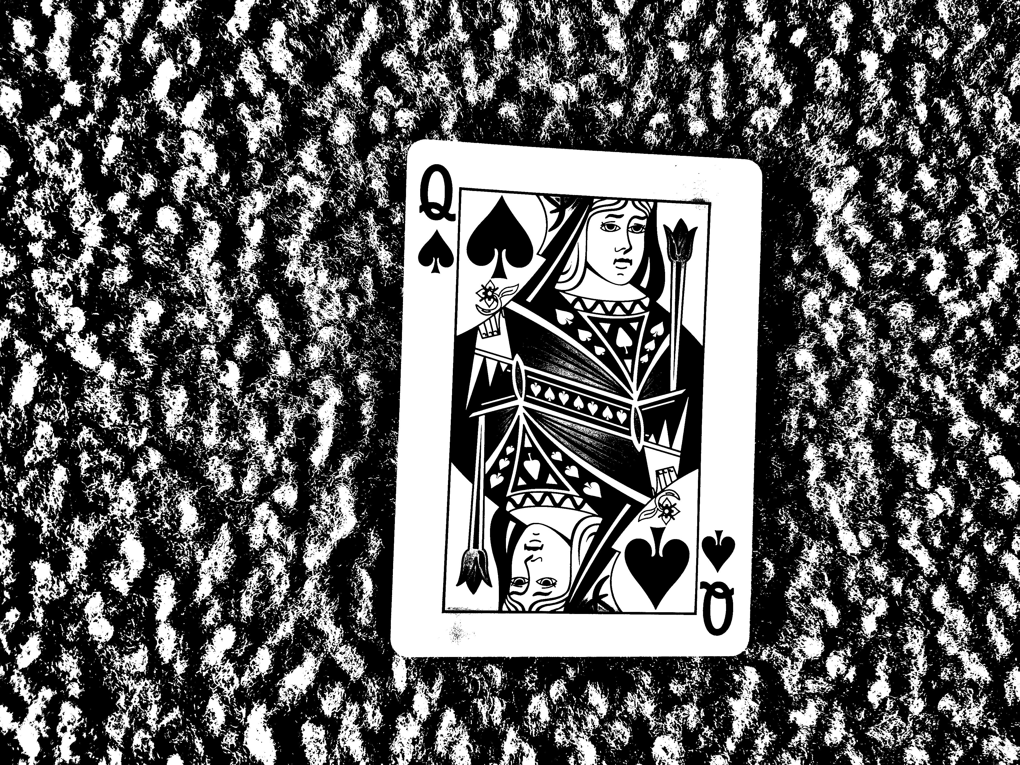
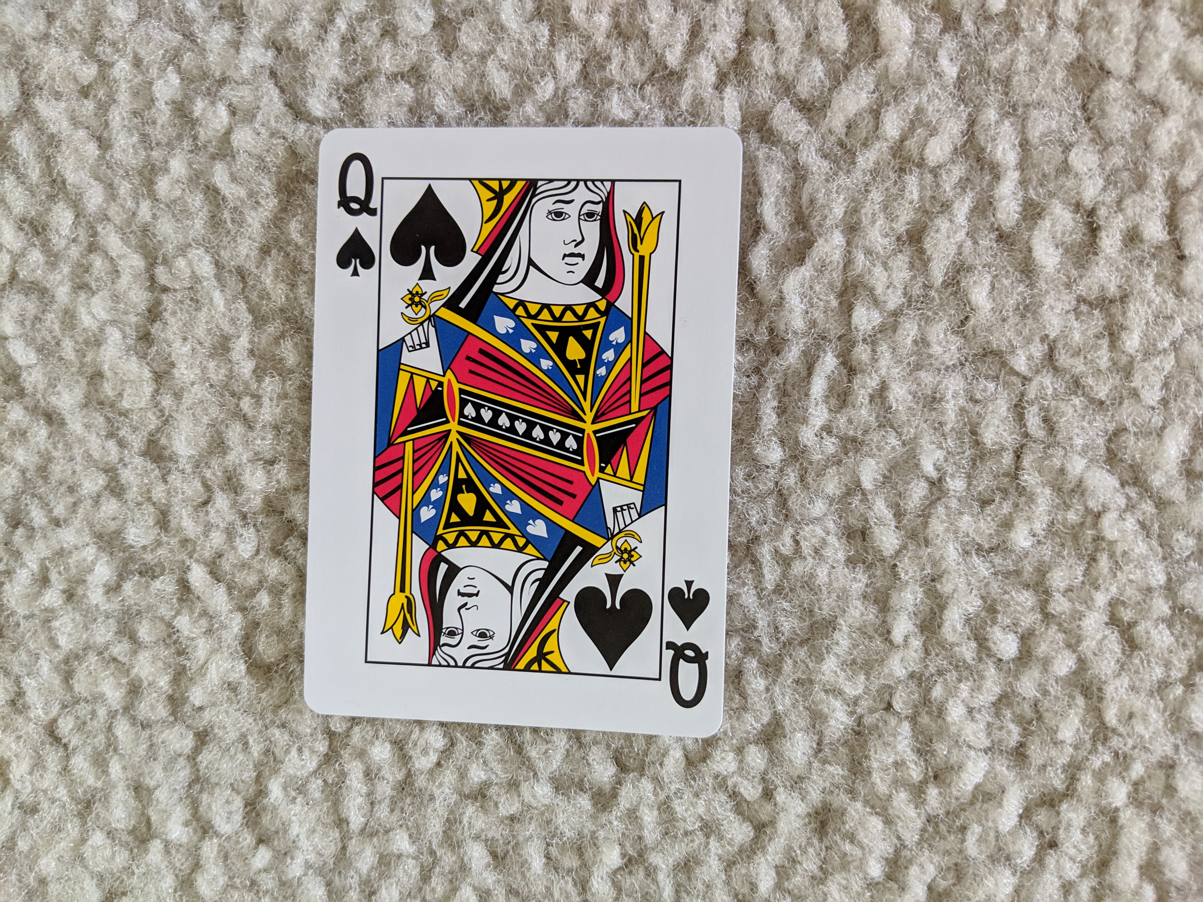
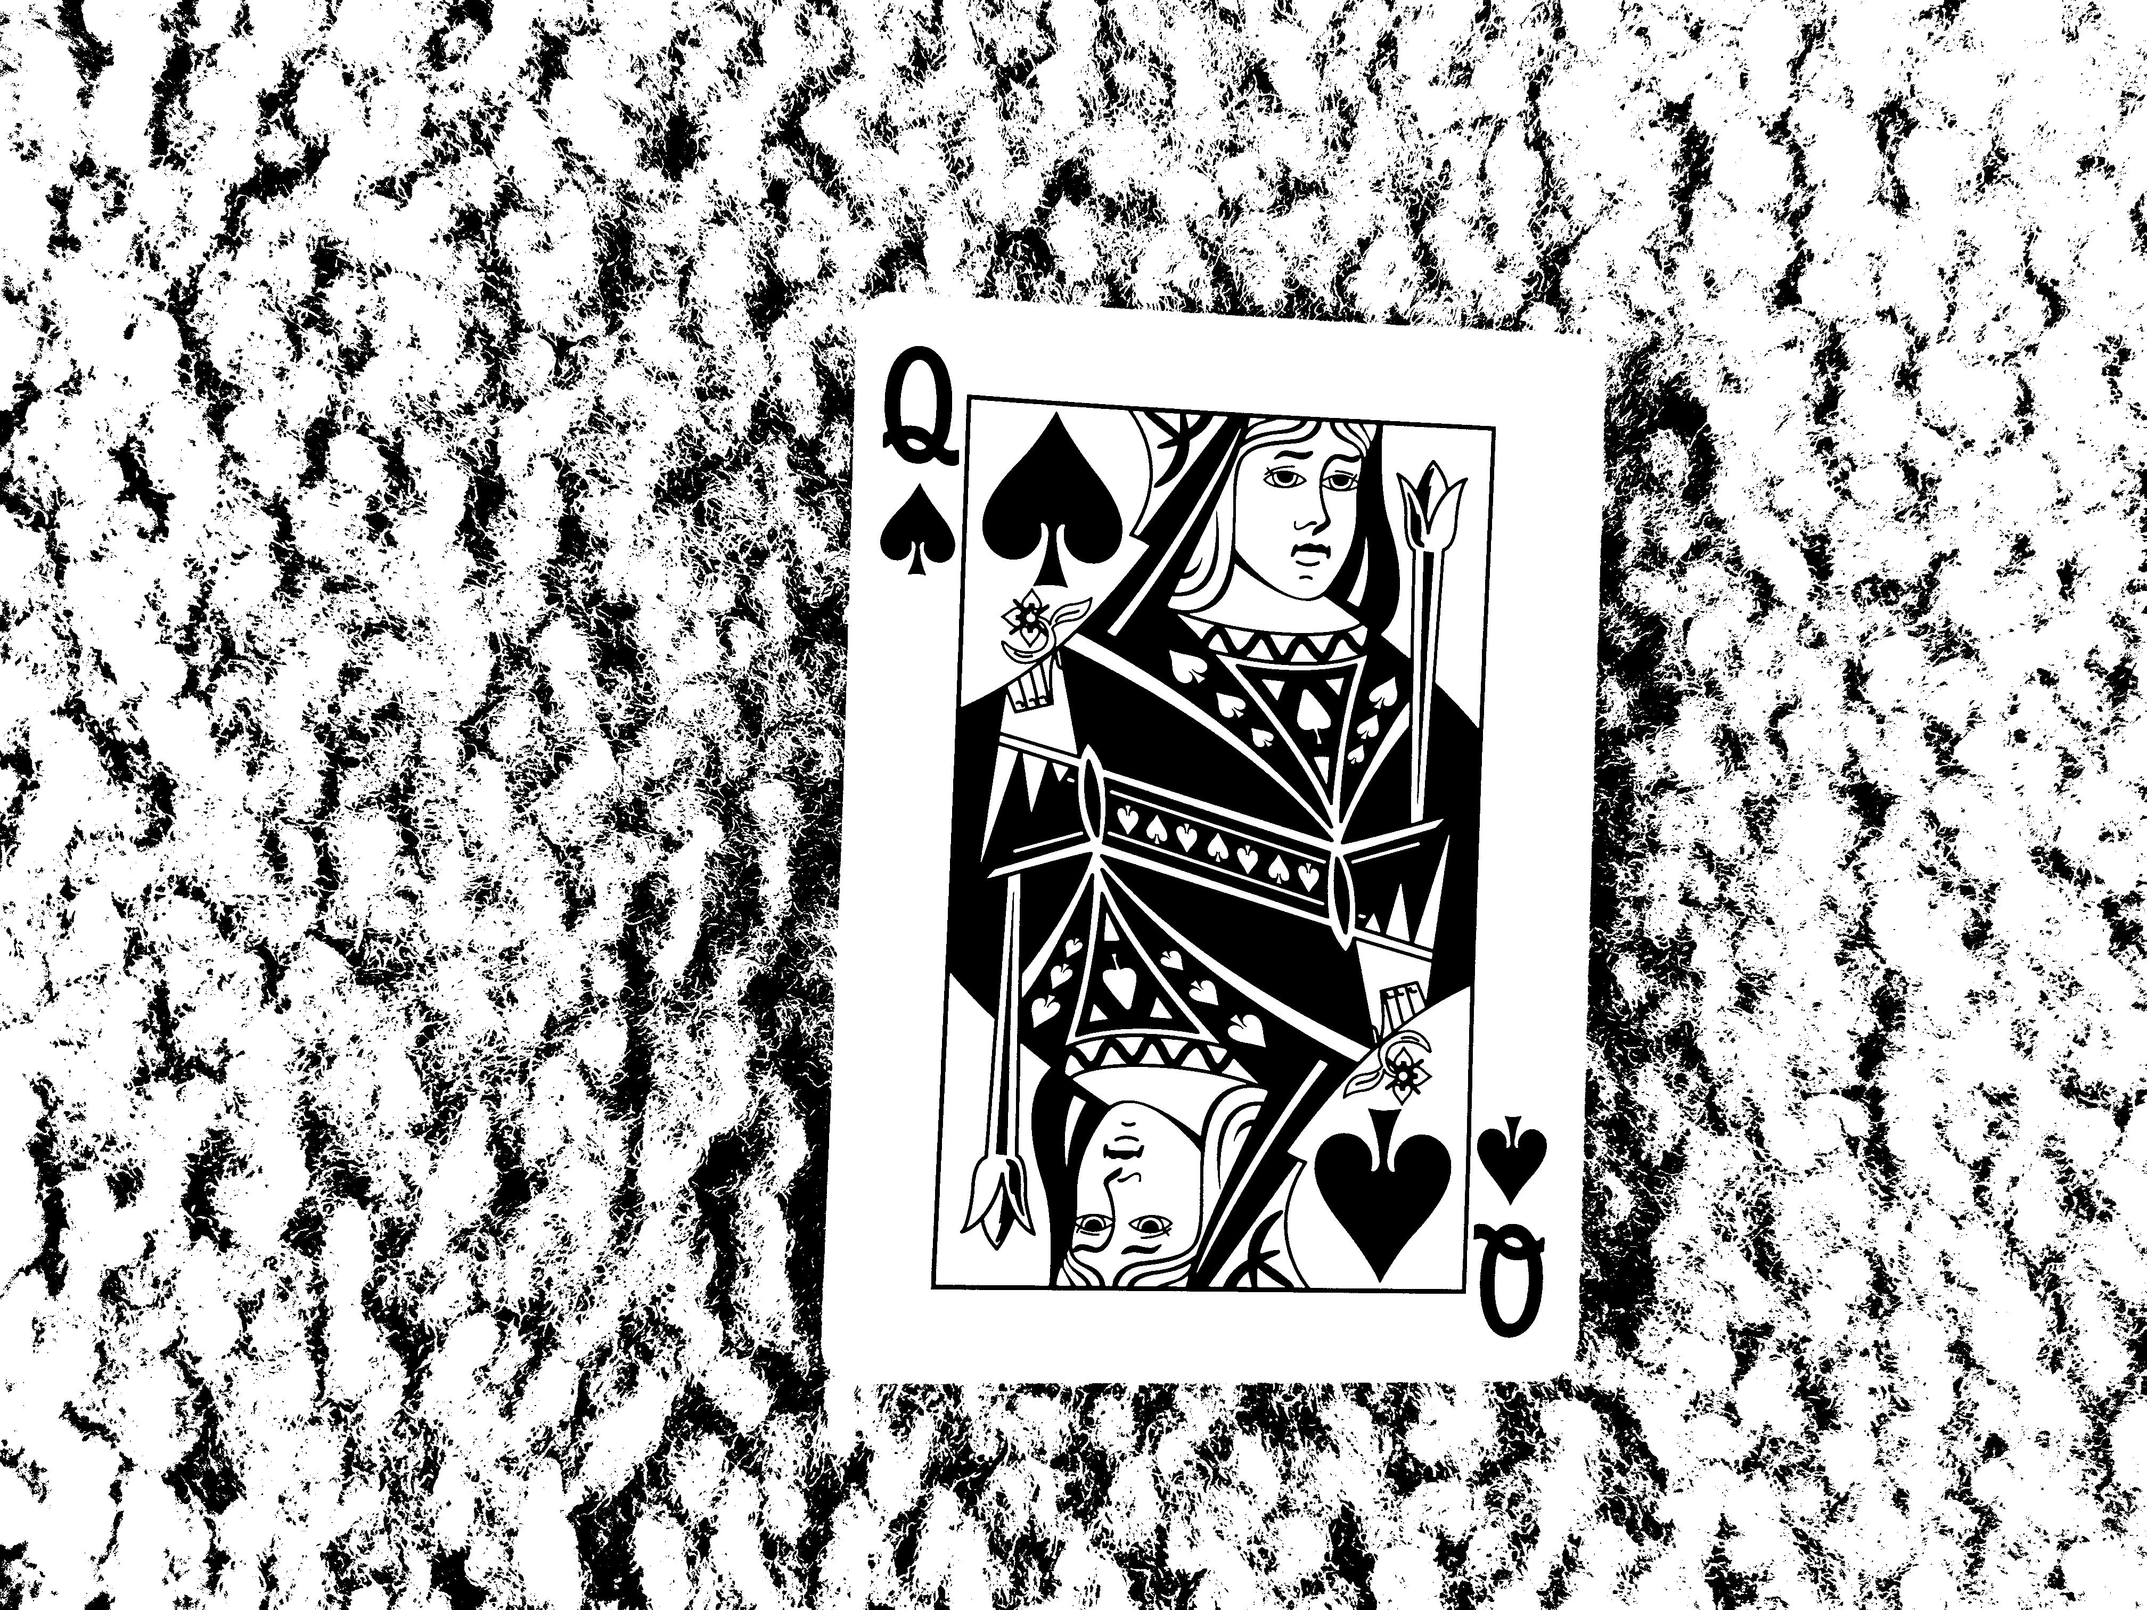
Challenges and Initial Results
Initial Challenge: Background removal
Bright, non-uniform backgrounds are not easy to remove.
Adaptive Thresholding
Base Image
Otsu’s Method

